Slide 1
What might be wrong?

Slide 2
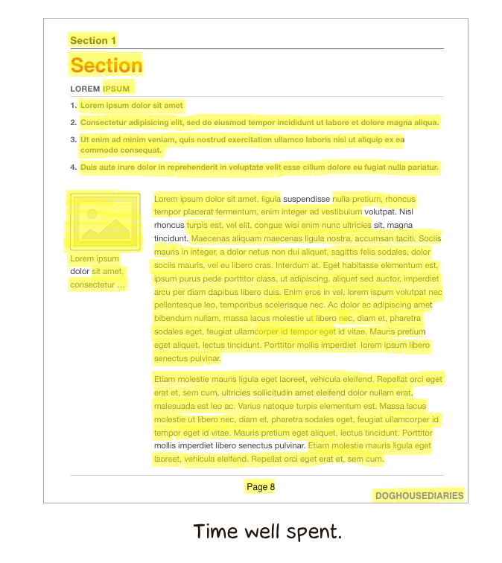
Death by highlighter
Students don’t know how to take effective notes so they’re highlighting everything and remembering nothing.
Teach them to colour code highlighting e.g. Different colours for: Precise facts
Analysis
Teach them to summarise

Slide 3

You’re not flipping learning
You’re spending too much time in lesson on uni-structural or multi-structural understanding.
Teacher contact time is precious. Always consider the best use of lesson time.
Set pre-learning homework so that the students come to the lesson with basic understanding and you can do the difficult stuff in the lesson where you will be needed.

Slide 4
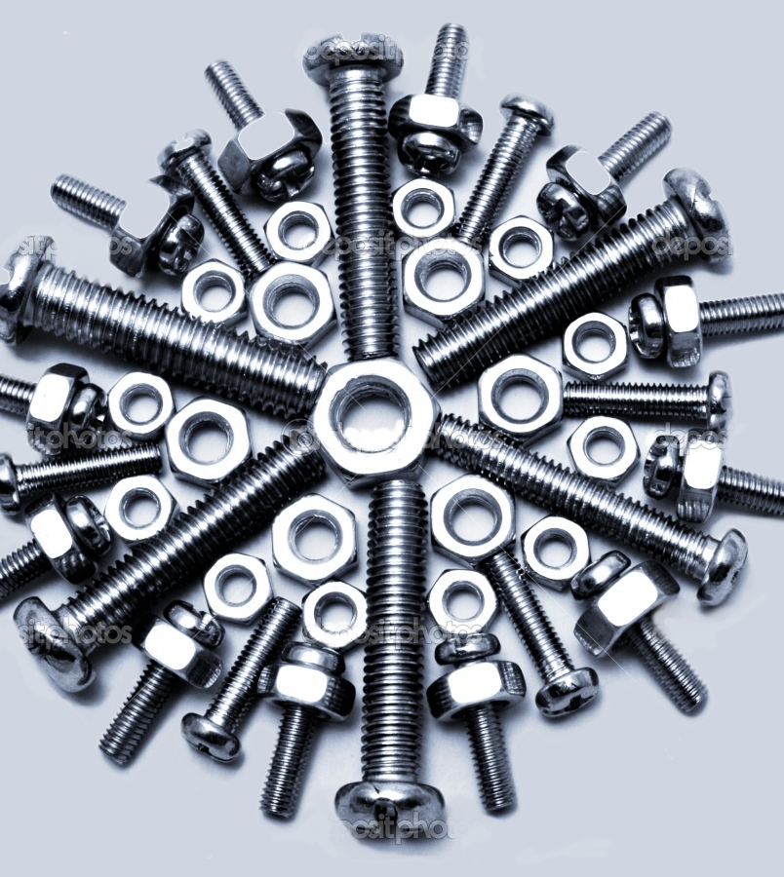
You’re not focusing on the nuts & bolts
Have you:
Broken down the assessment skills that the students need
Explicitly addressed these in feed forward so that students can ‘unpick’ unseen assessments
For an example see Exemplar Essay Self Assessment 1 @lovelearningideas.com
Make sure that your improvement strategies are generic enough to improve unseen assessments the student might face.

Slide 5
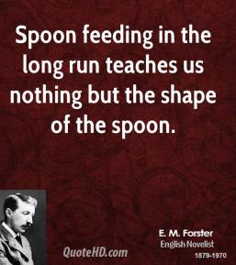
Students are teacher-fed not teacher-led
Students often like the easy option. Make them work for it.
Build in Bjork’s Desirable Difficulties.
Make students answer the probing questions that you set them.
Don’t do students’ thinking for them.

Slide 6

They can’t see the big picture
You can see the big picture because you’re the expert. Can they?
Do the students have an accurate map of the content?
Does their folder or book organisation facilitate understanding of the big picture?
Can the students retrieve or connect information from across the content?
Ensure that students create accurate content maps and that their book/ folder organisation facilitates content mapping.

Slide 7
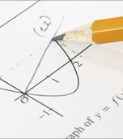
They’re the wrong tests!
Are you using frequent low-stake testing?
Are you providing interleaved rather than blocked assessments?
Are you spacing learning?
Are you providing students with realistic assessments in terms of content and length?
Are you varying context so students can apply what they’ve learned to unseen assessments in exam conditions?

