Slide 1
Failing to Succeed

Slide 2
Unless you are prepared to fail, you won’t succeed
Carol Dweck argues that in order to succeed we need a ‘growth mindset’
Fixed Mindset | Growth Mindset
My intelligence is fixed | Intelligence is expandable. With hard work I can become more intelligent
Hard work won’t make me any cleverer | I can become cleverer by working hard
I avoid difficulty, struggle and failure | I recognise that difficulty, struggle and failure help me to learn
Learning is finite: I can ... I can’t... | Learning is a continuum: I am learning to... I can’t yet...
Likely to plateau early | Reaches higher levels of achievement

Slide 3
Unless you’re prepared to struggle you won’t reach your potential
“ [The] conditions which induce the most errors during acquisition are often the very conditions that lead to the most learning.” Robert Bjork (2013)

Slide 4
Don’t cheat yourself with easiness
“It doesn’t help a student to tackle a difficult task if they succeed constantly on an easy one.” Carol Dweck

Slide 5
It takes hard work to achieve real mastery
Purposeful practice of something makes you better at it.
“The key to success in any field is, to a large extent, a matter of practicing a specific task for a total of around 10,000 hours.” Gladwell (2008)

Slide 6
The greatest successes have been failures
Einstein did not read until he was 7
Walt Disney was fired for lacking imagination
The Beatles were rejected by 2 record companies
Beethoven’s teacher described him as “hopeless”
12 publishers rejected the first ‘Harry Potter’ book
James Dyson spent 15 years creating 5,126 versions of his vacuum cleaner that failed before he made one that worked

Slide 7
Every lesson push for your failure line

Slide 8
Tips for success
If there’s no struggle you’re not stretching yourself
If you’re not making mistakes you’re not stretching yourself
Never say “I don’t know”
Use modal language to take chances:
Might, could, perhaps, if, possibly, arguably

Slide 9
‘Unstick’ yourself
Use your brain
Use your folder
Ask a friend
Look it up
Don’t be spoon-fed

Slide 11
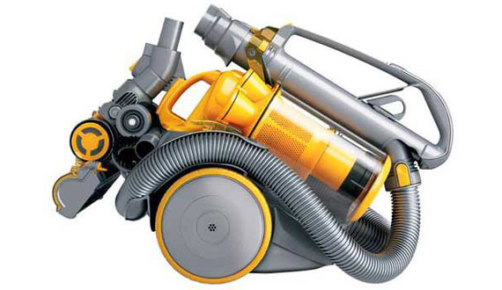
If James Dyson can do it 5167 times, so can you...

